Slide 1
Particle Swarm Optimization

Slide 2
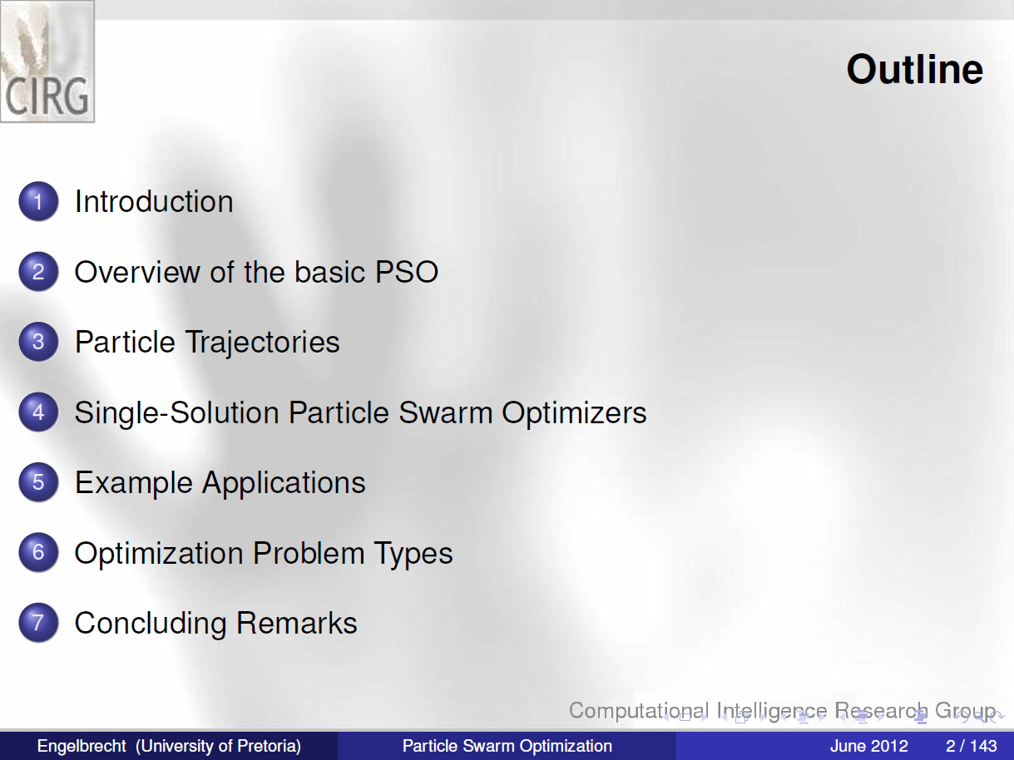

Slide 3
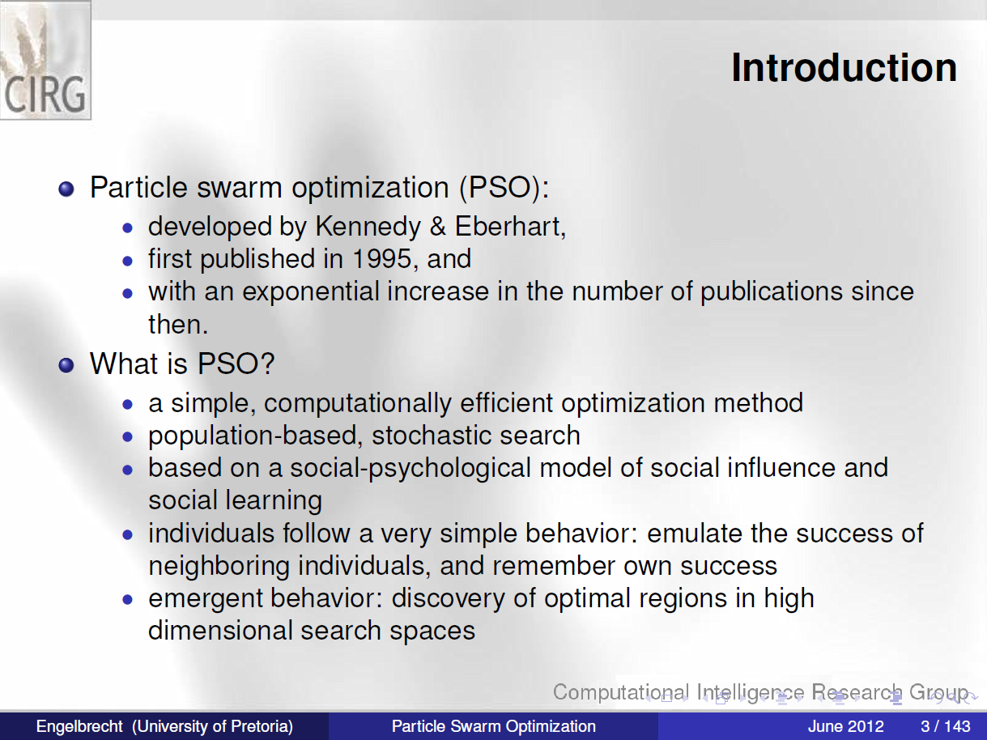
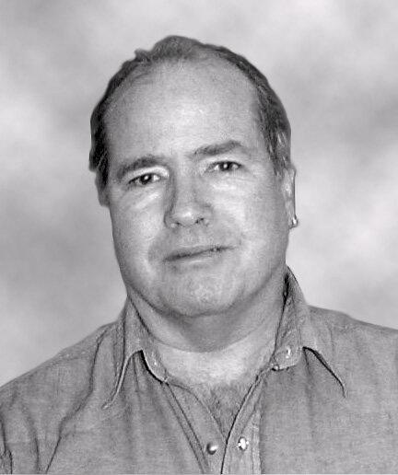
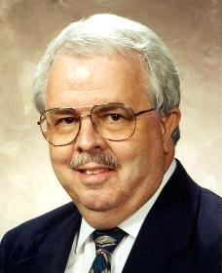
James Kennedy
Social-psychologist
Russel Eberhart
Electrical engineer

Slide 4
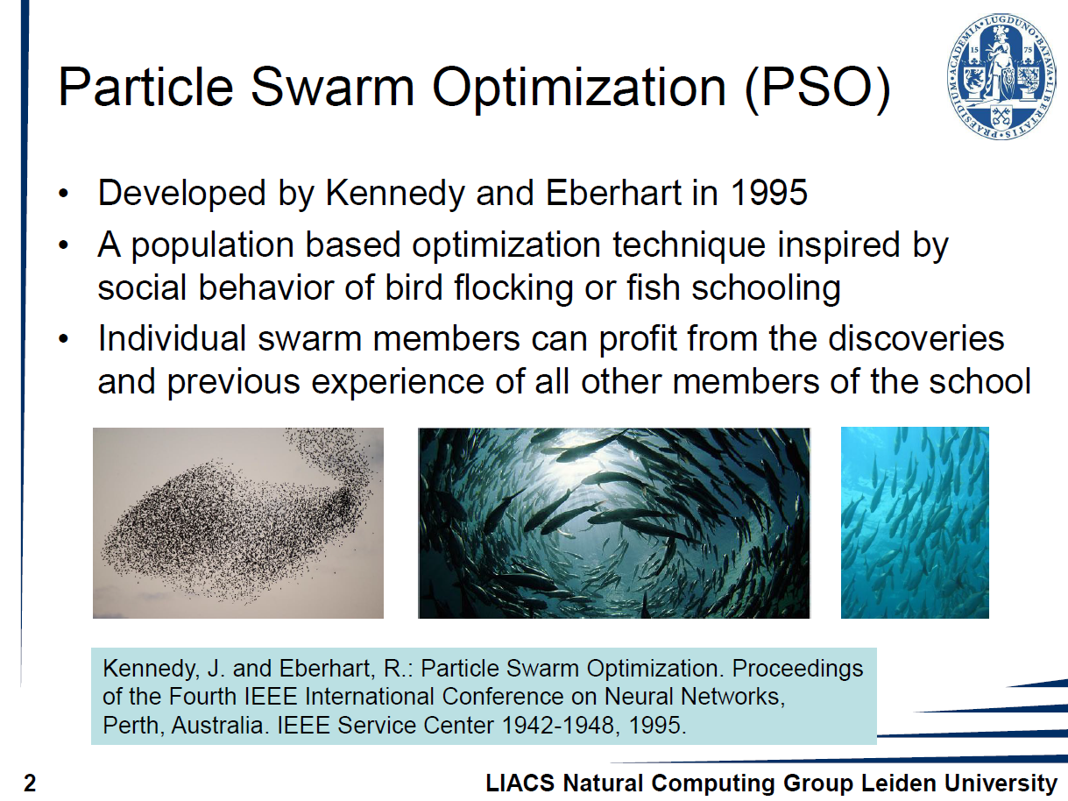

Slide 5
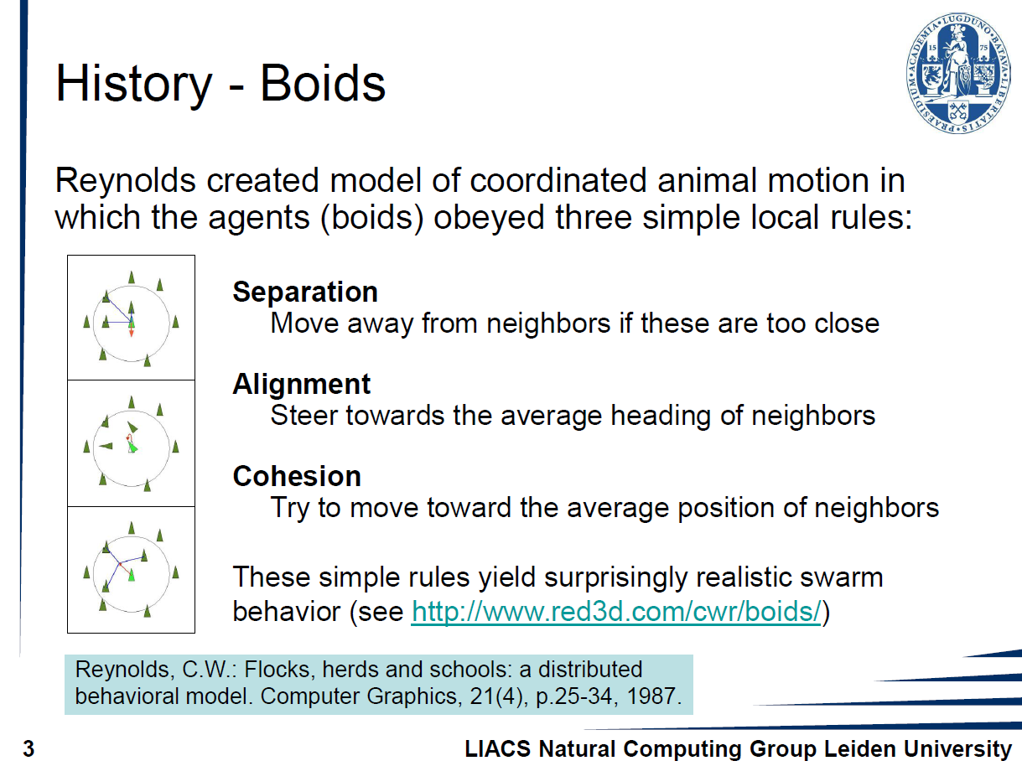

Slide 6
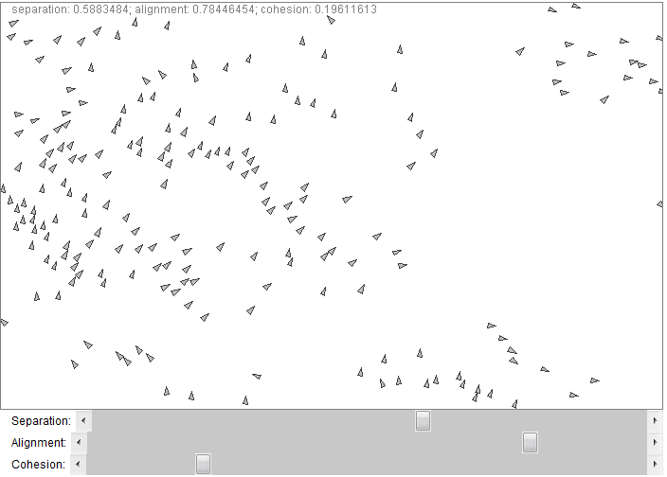
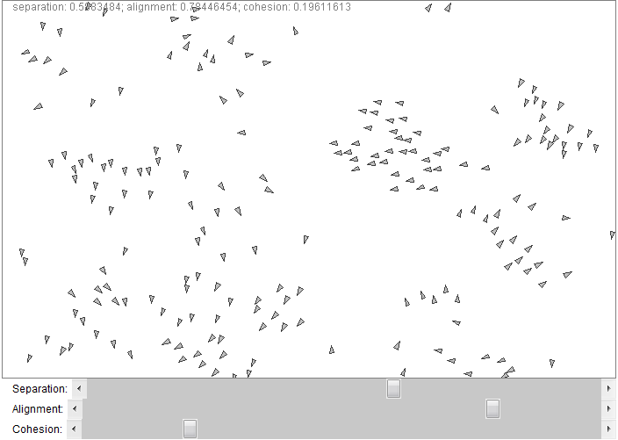
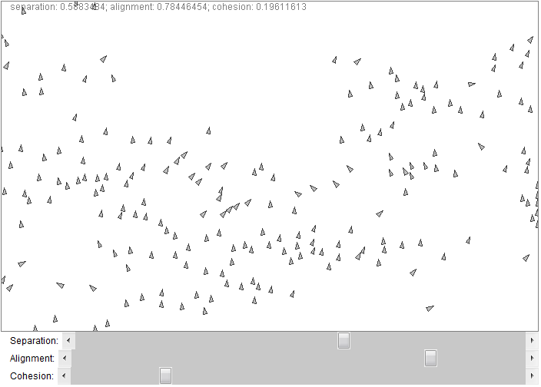
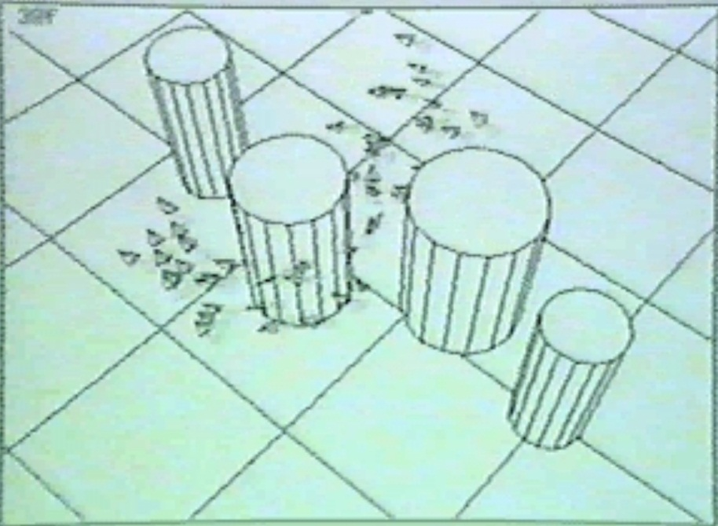

Slide 7
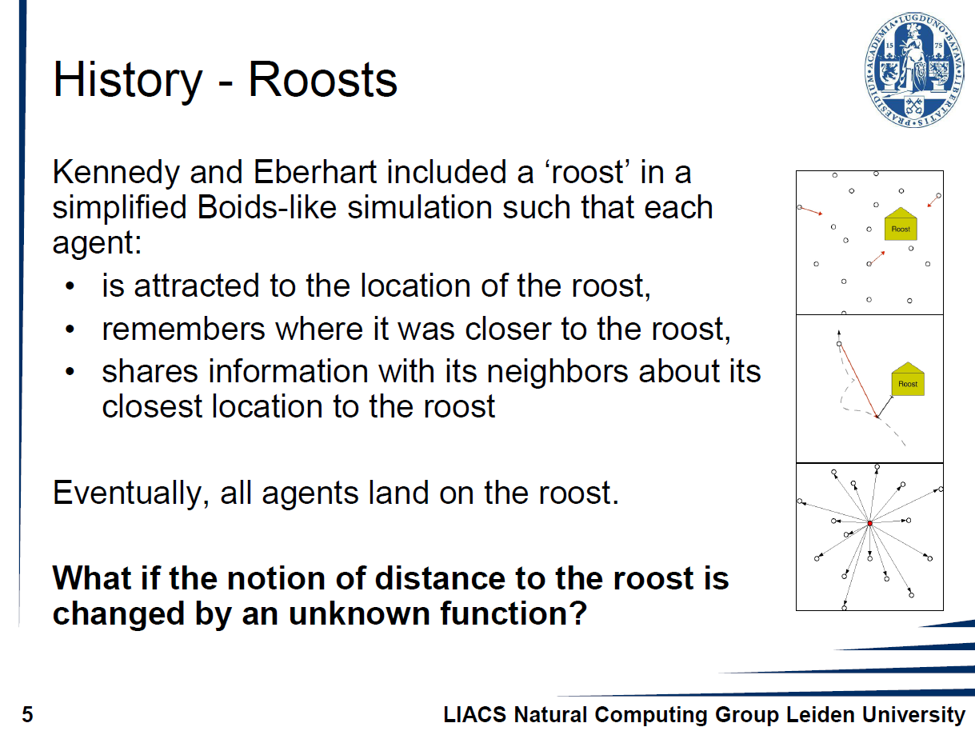

Slide 8
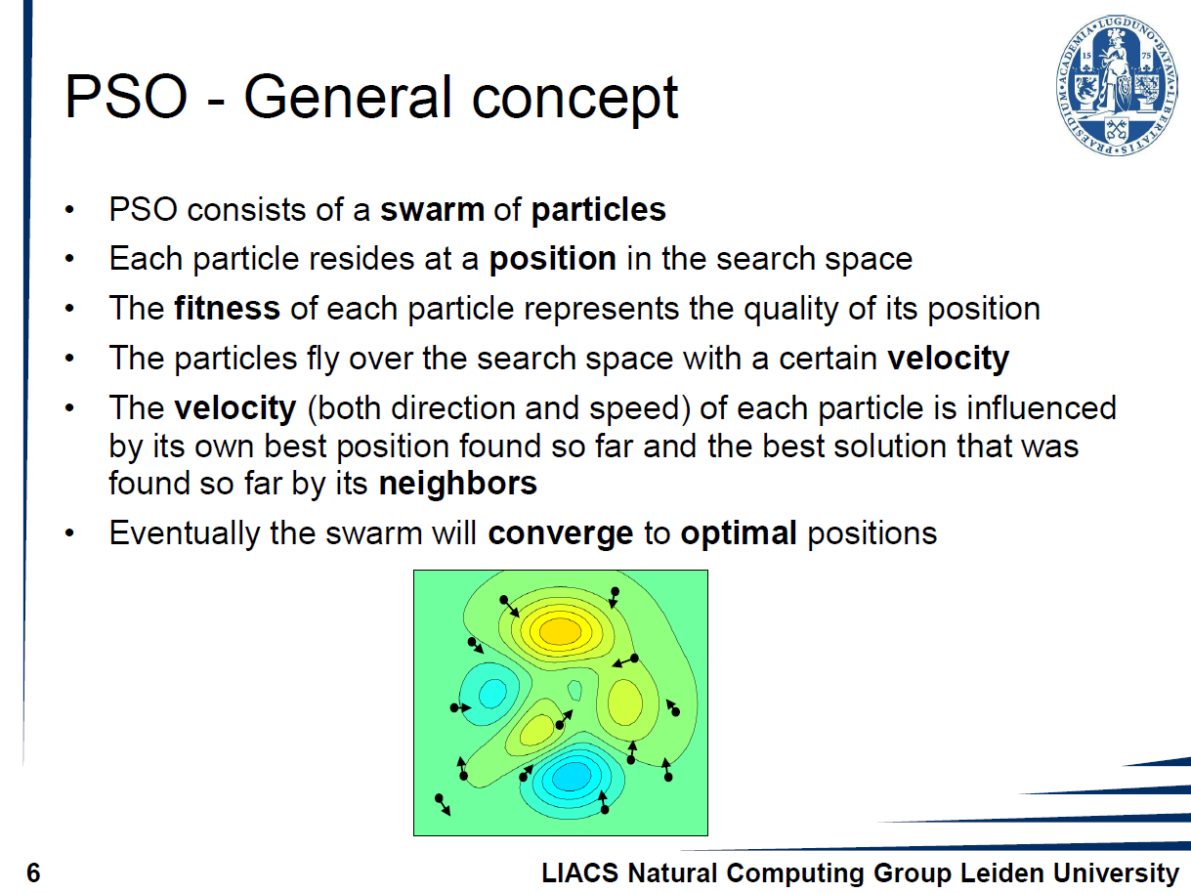

Slide 9
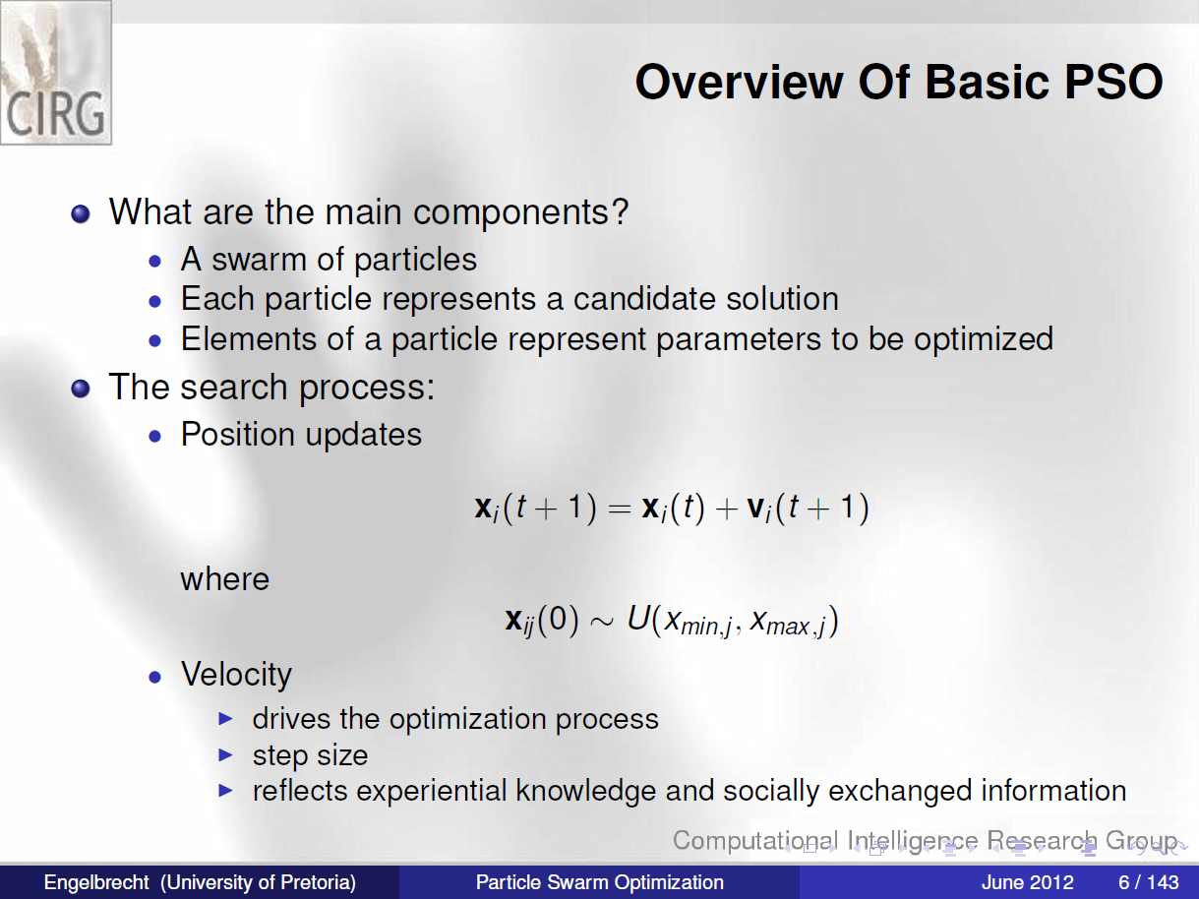

Slide 10
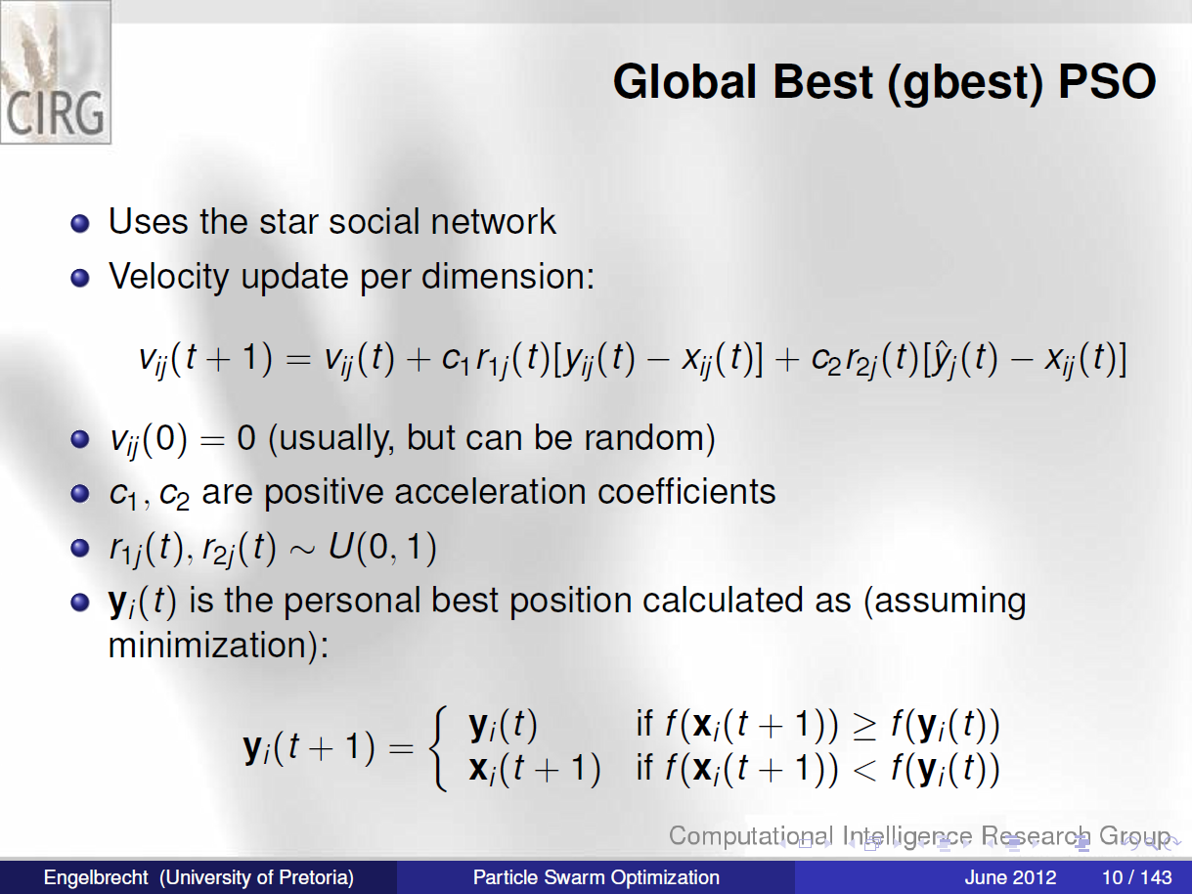

Slide 12
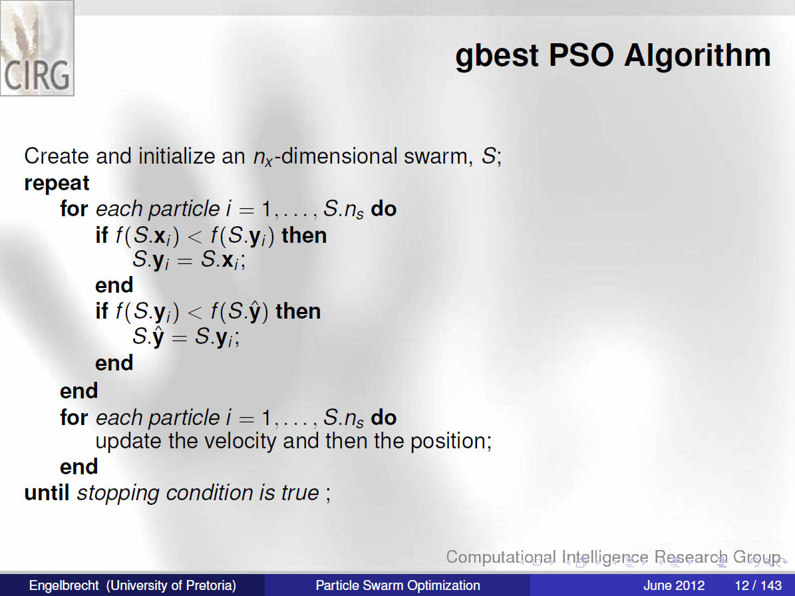

Slide 15
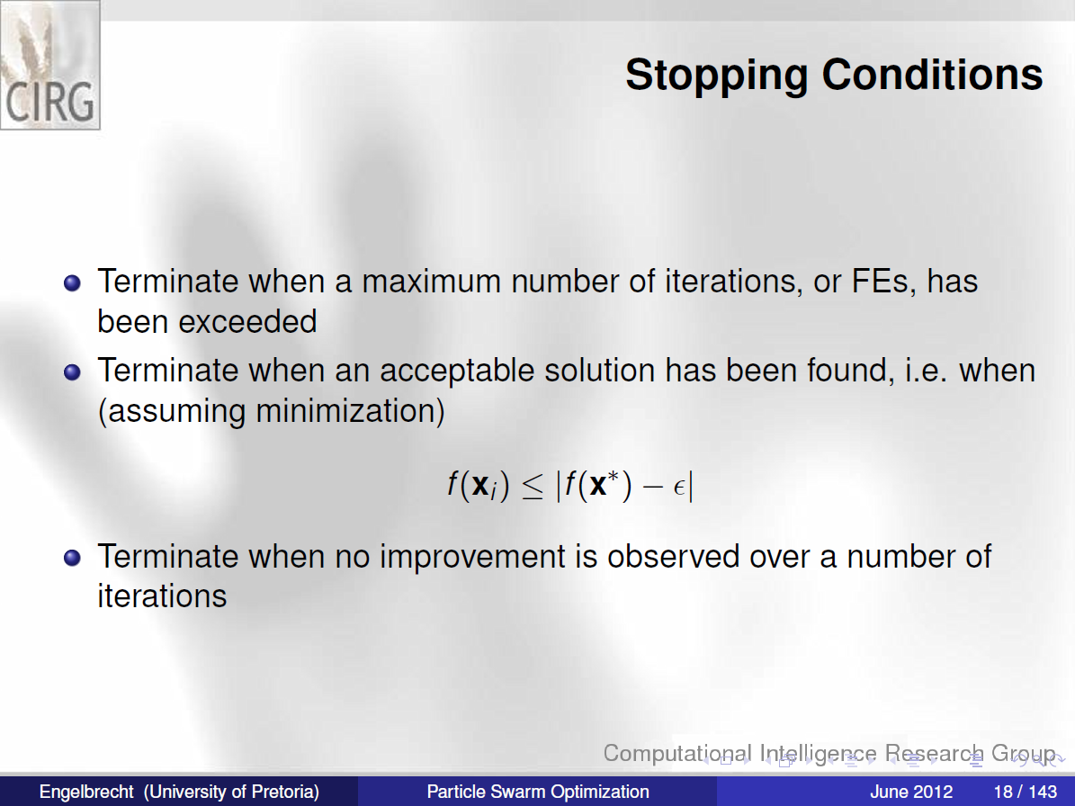

Slide 16
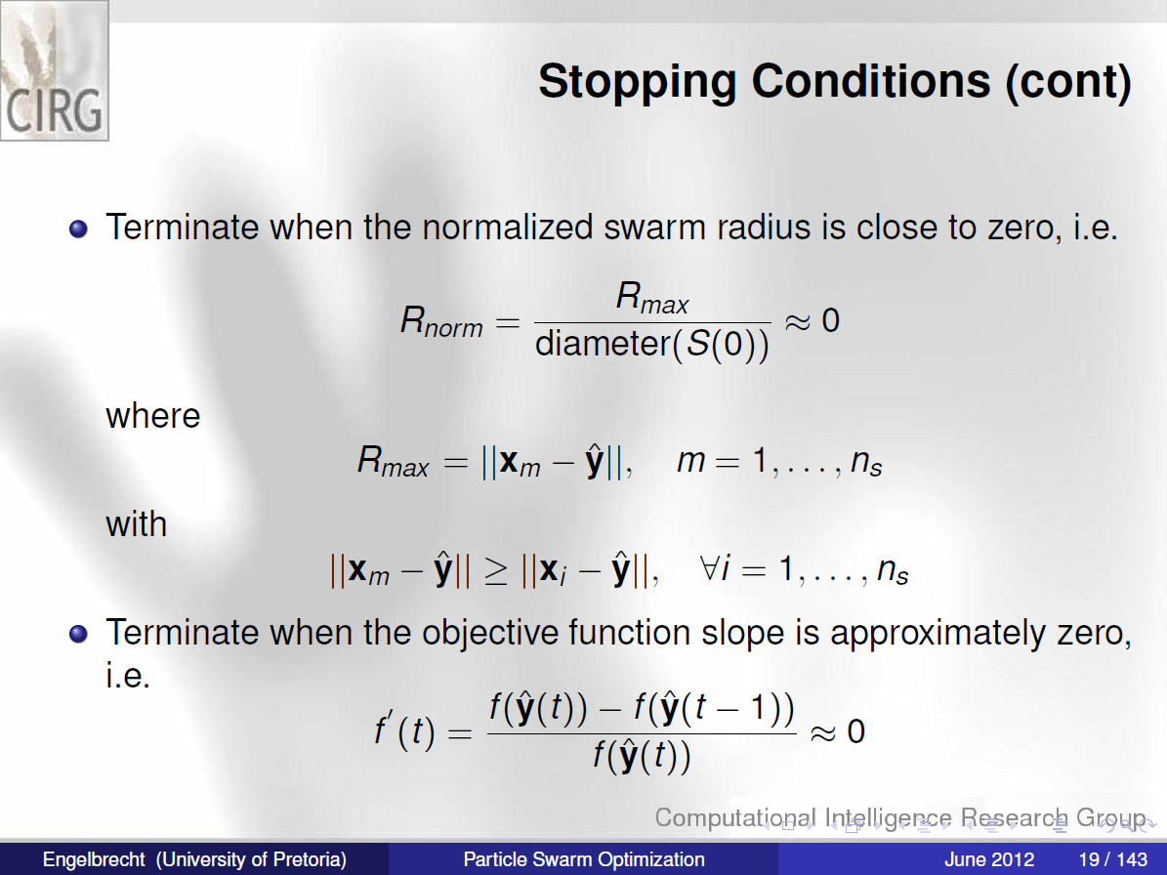

Slide 17
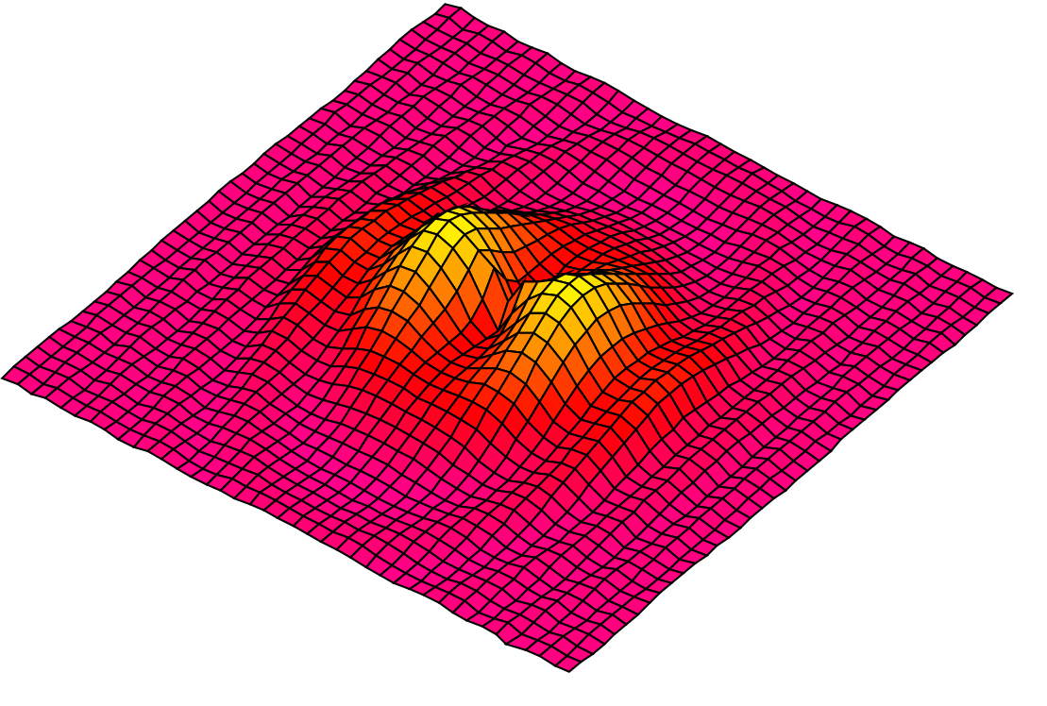
Initialization
Notes:
Here you have another nice search space.
First step: you put some particles on it. You can do it at random or on a regular way, or both. How many? In practice, for most real problems with dimension between 2 and 100, a swarm size of 20 particles works quite good.
There are some mathematical ways to give an estimation, but a bit beyond the scope of this talk. Also, as we will see some variants use an adaptive swarm size.
Second step: you define a velocity for each particle, usually at random. You can set all initial velocities to zero but, experimentally, it is usually not the best choice.
Remember that what we call “velocity” is in fact a move, just because time is discretized.

Slide 18
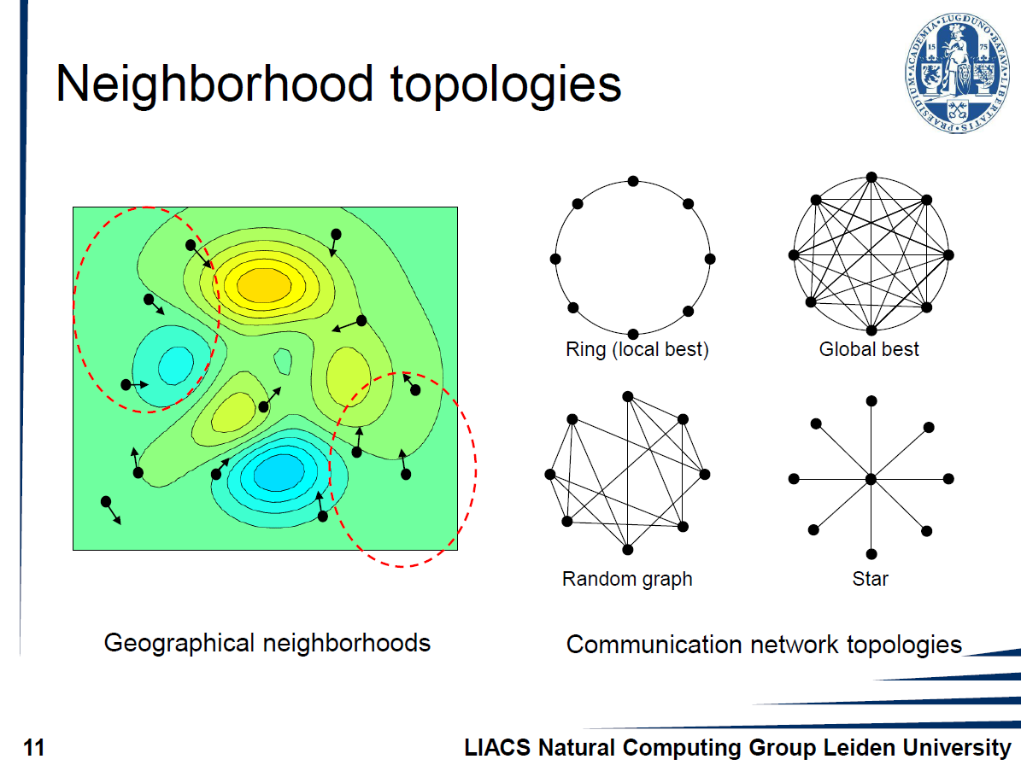

Slide 19
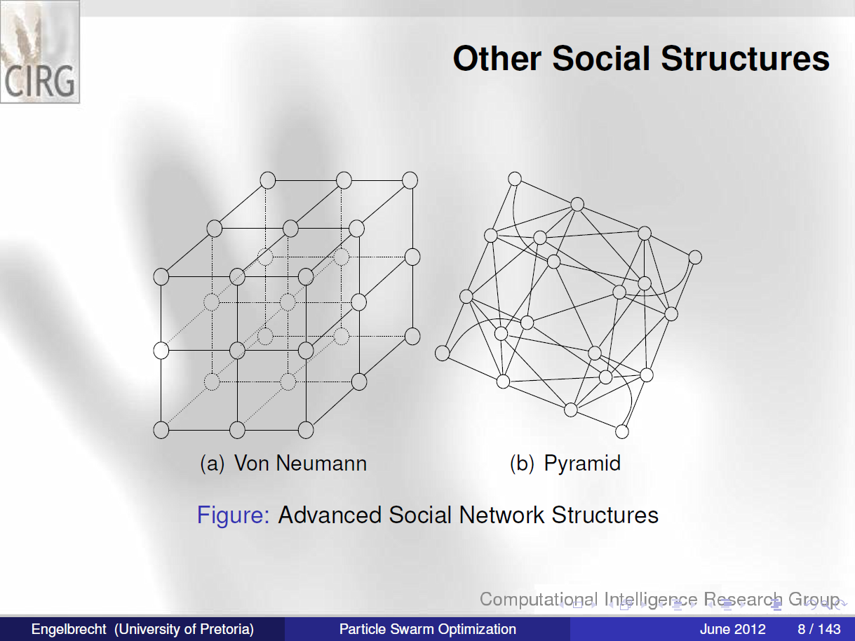

Slide 20
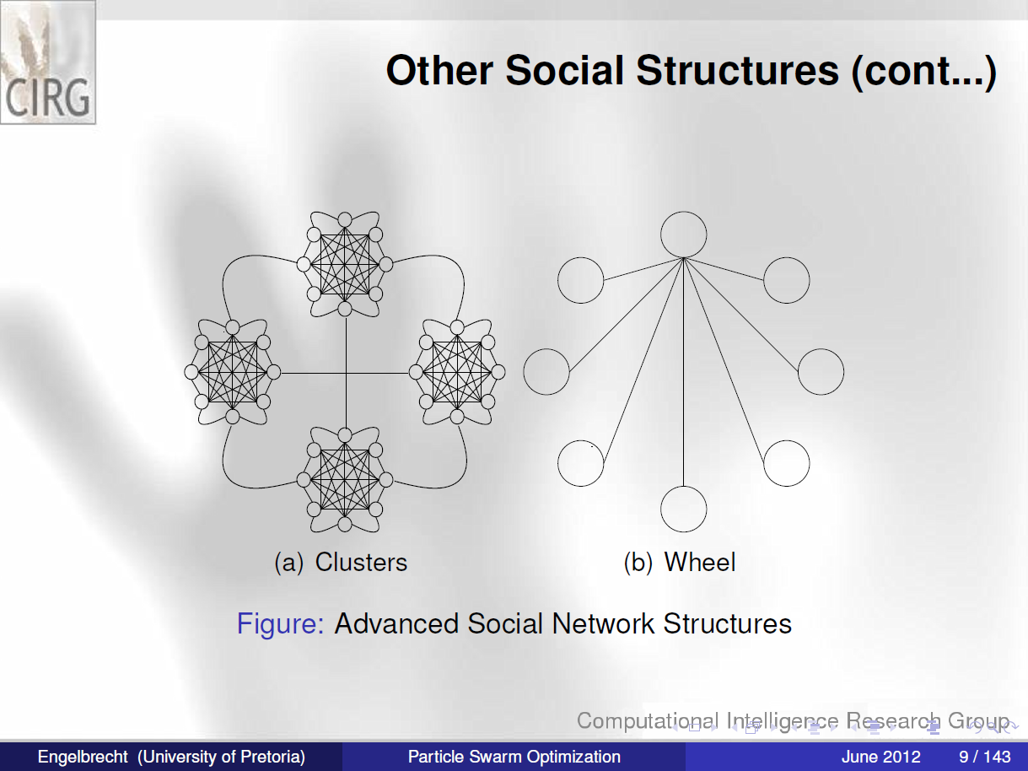

Slide 21
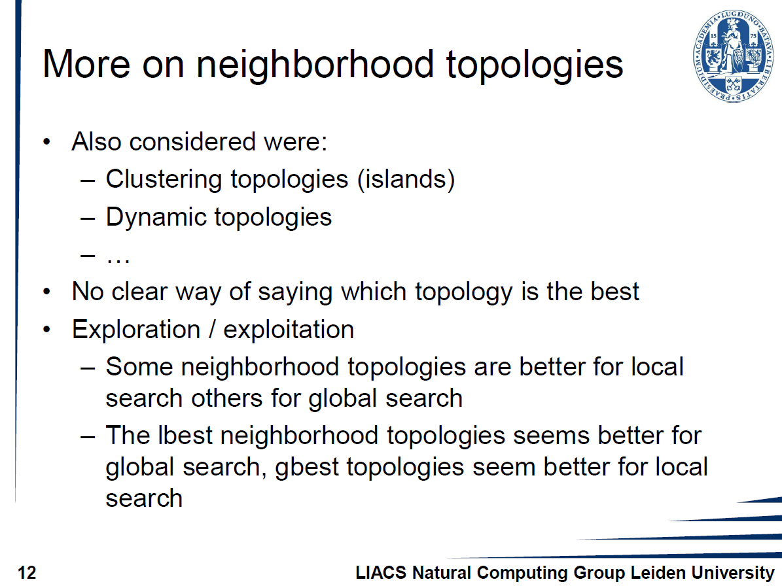

Slide 22
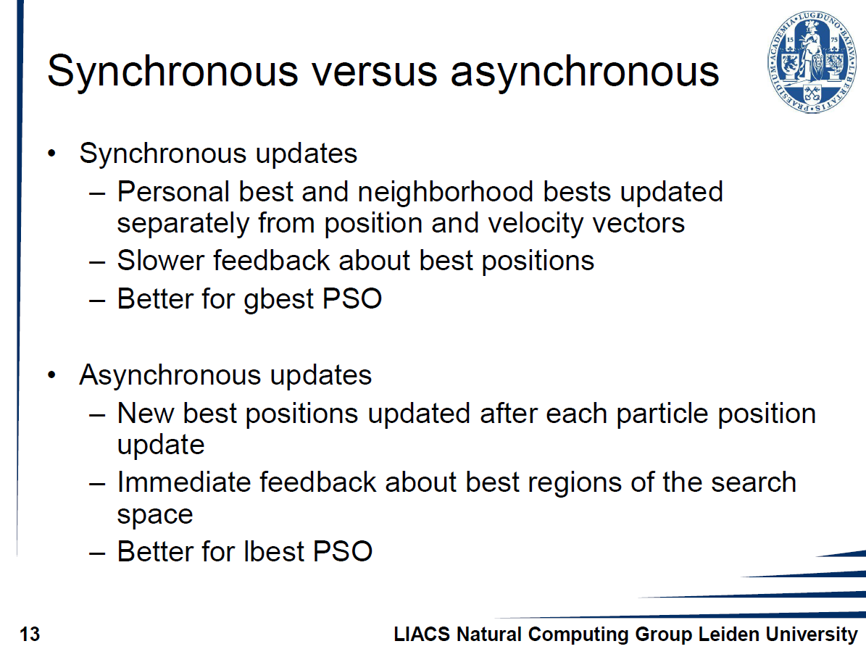

Slide 23
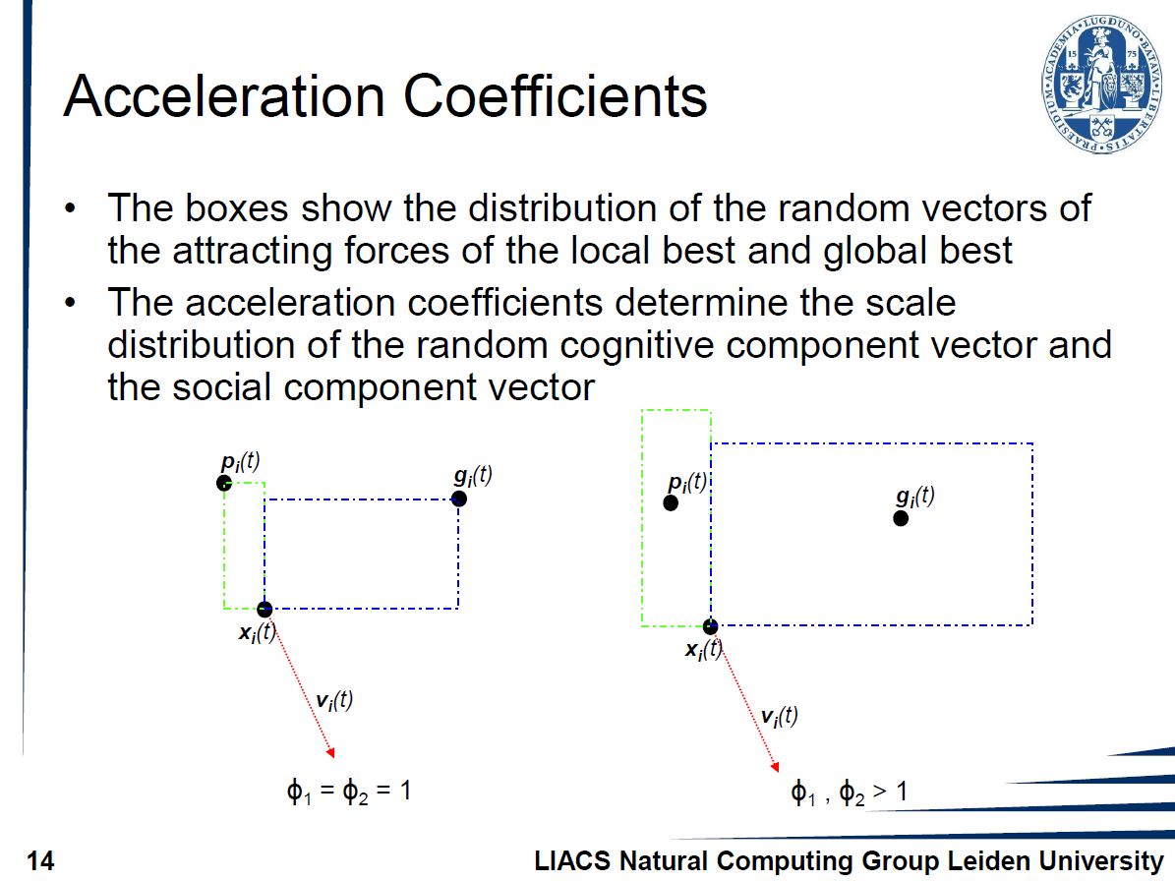

Slide 24
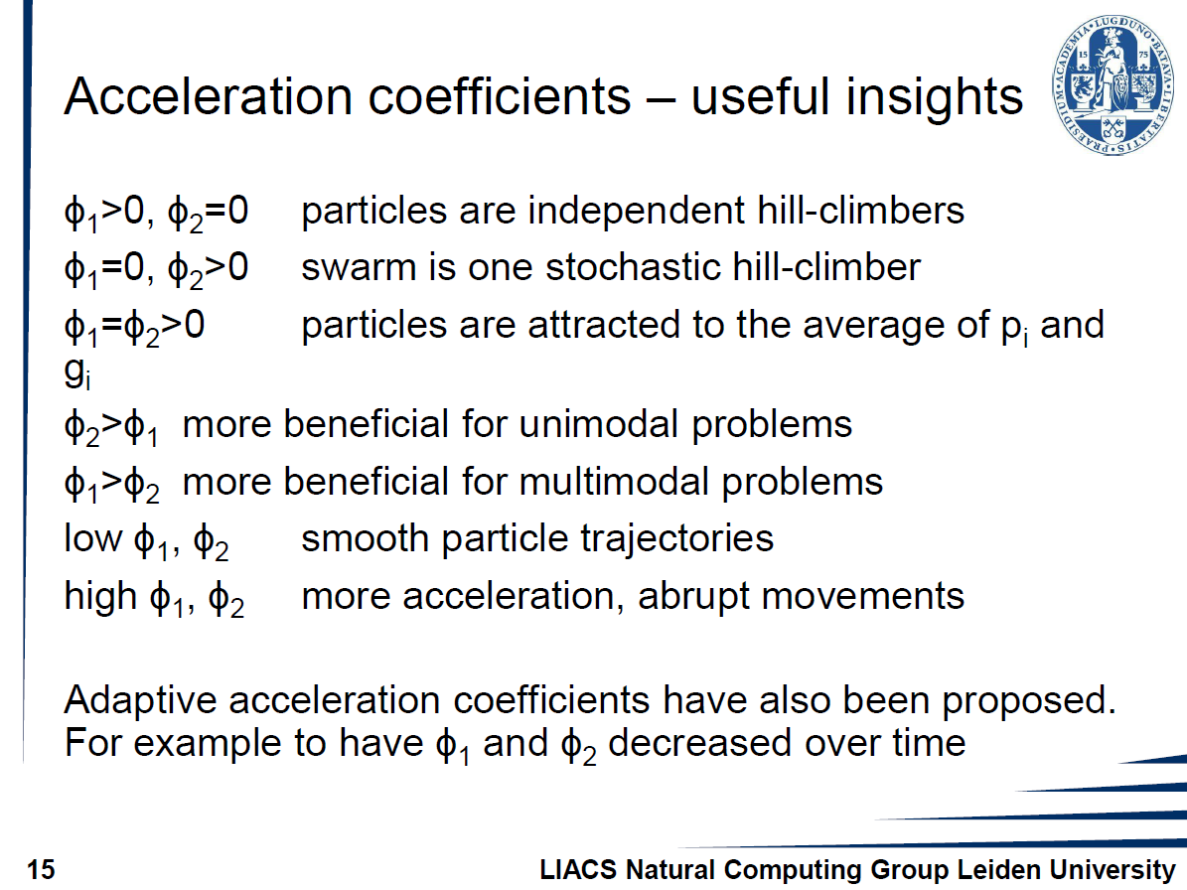

Slide 25
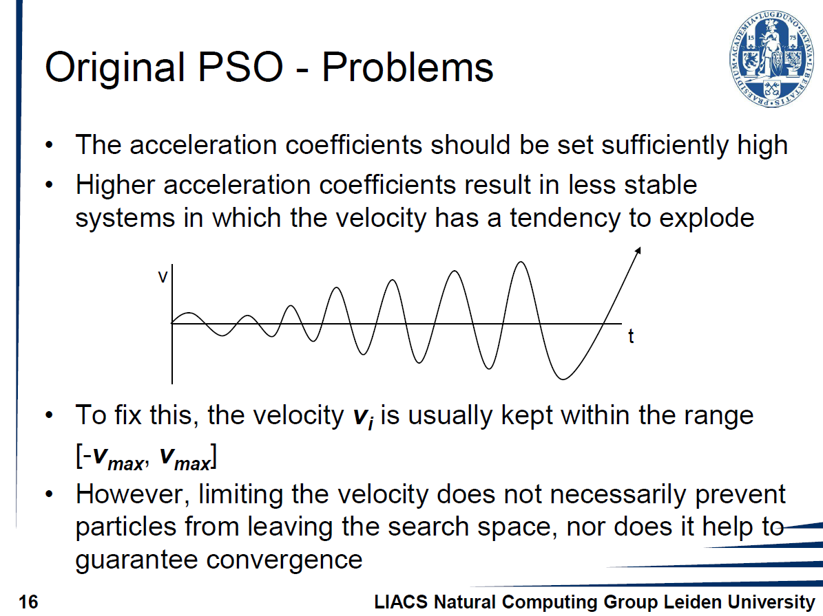

Slide 26
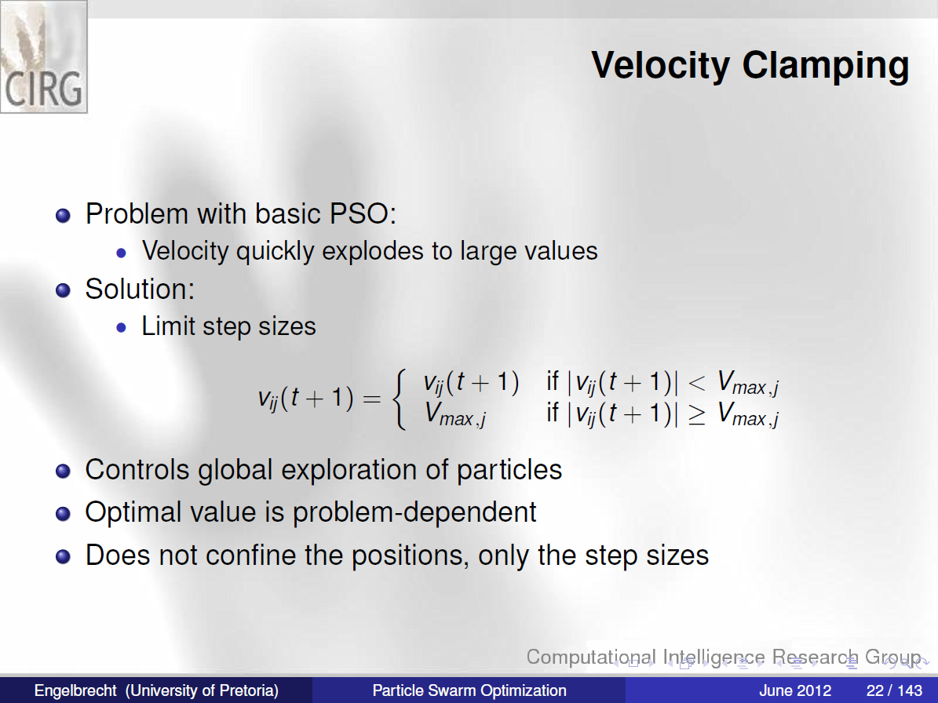

Slide 27
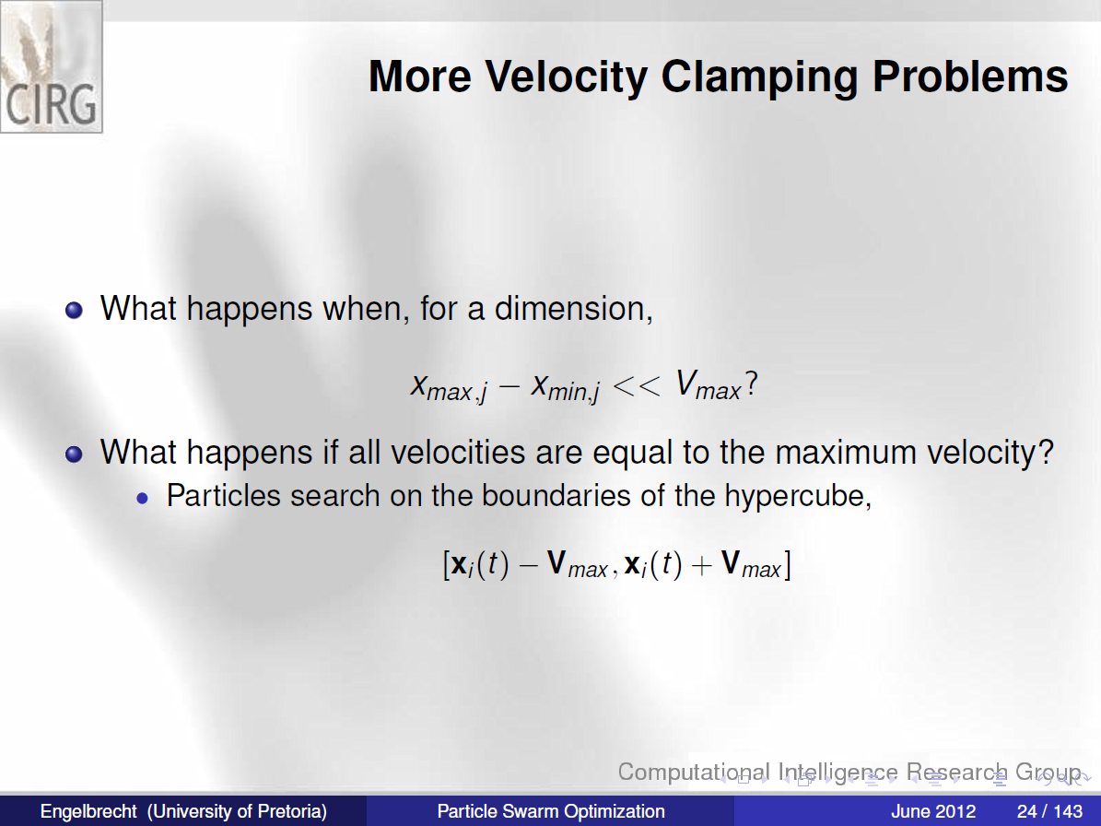

Slide 28
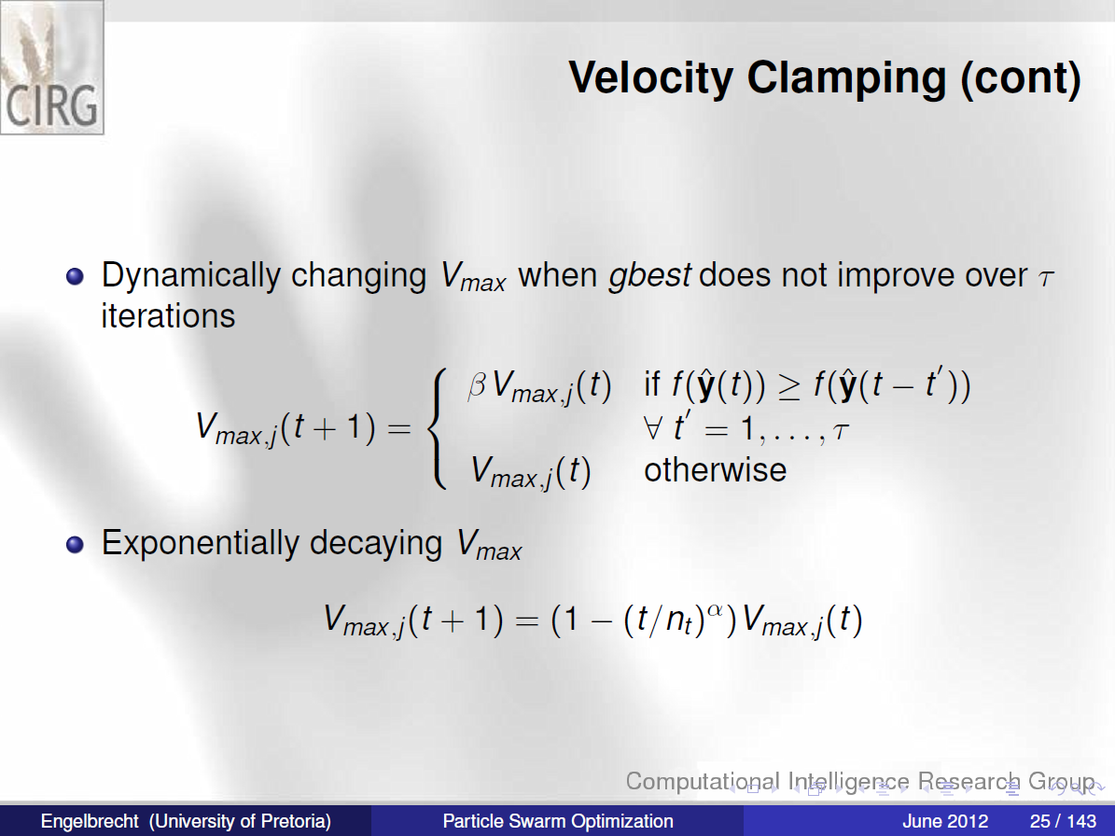

Slide 29
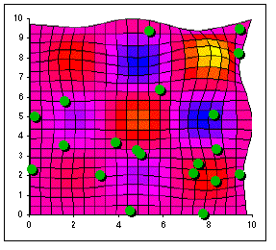

Slide 30
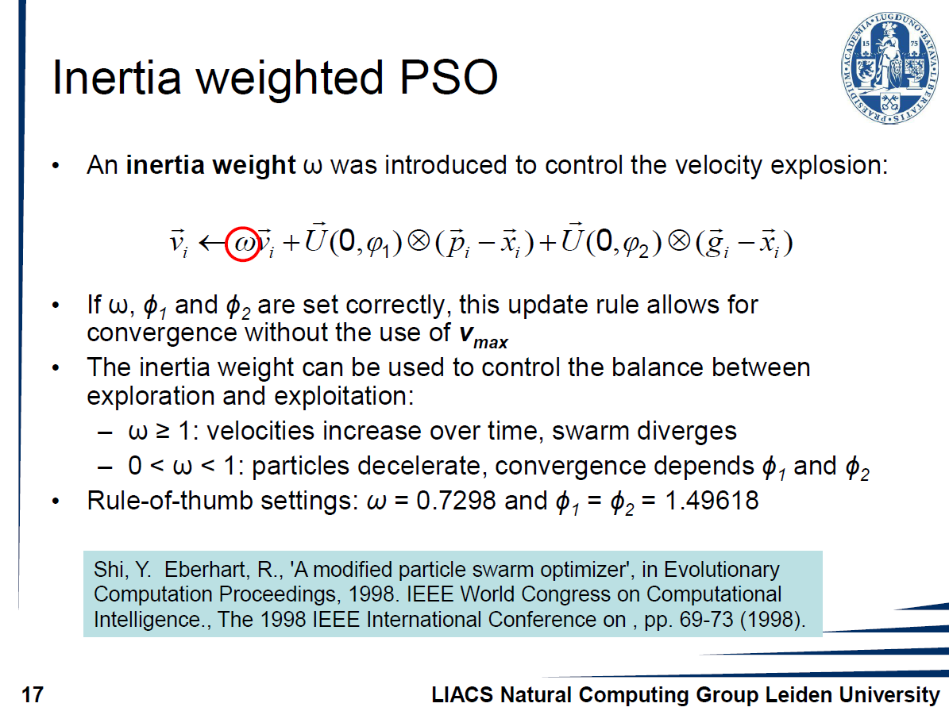

Slide 31
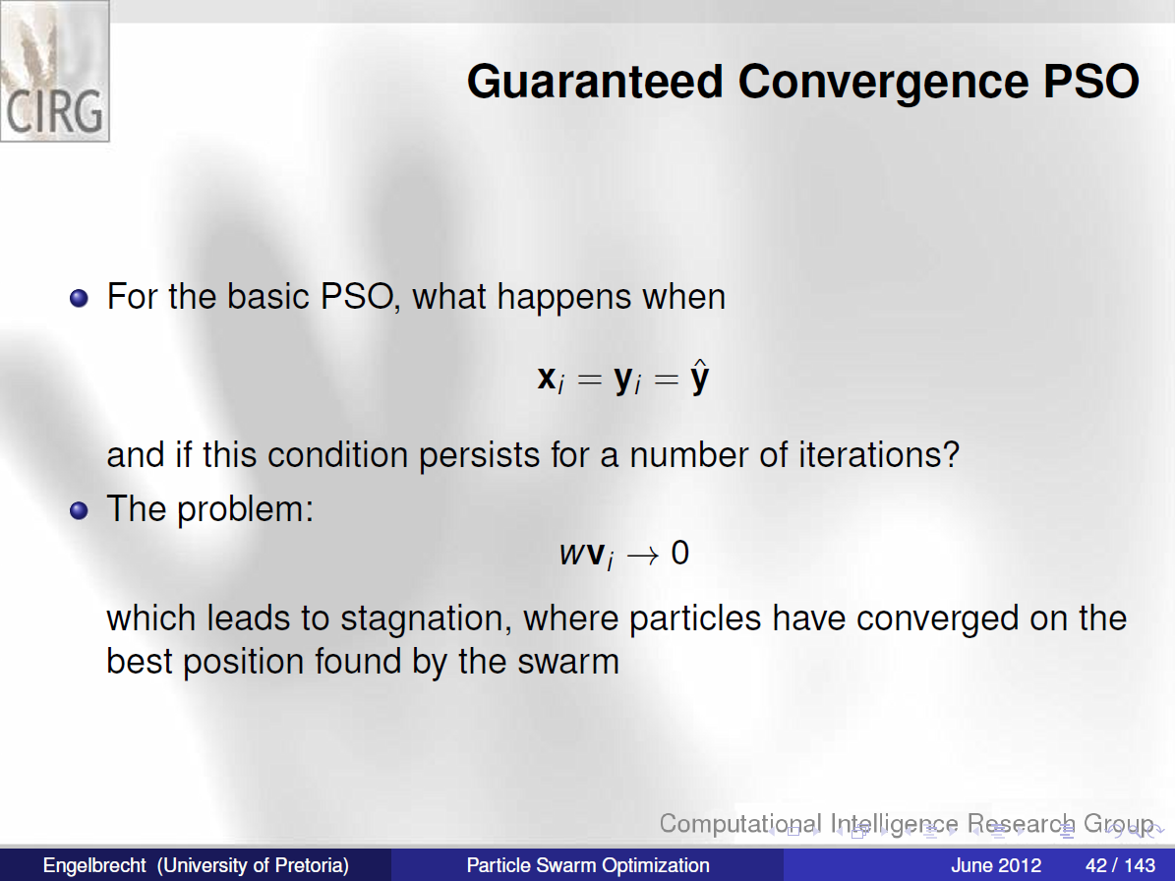

Slide 32
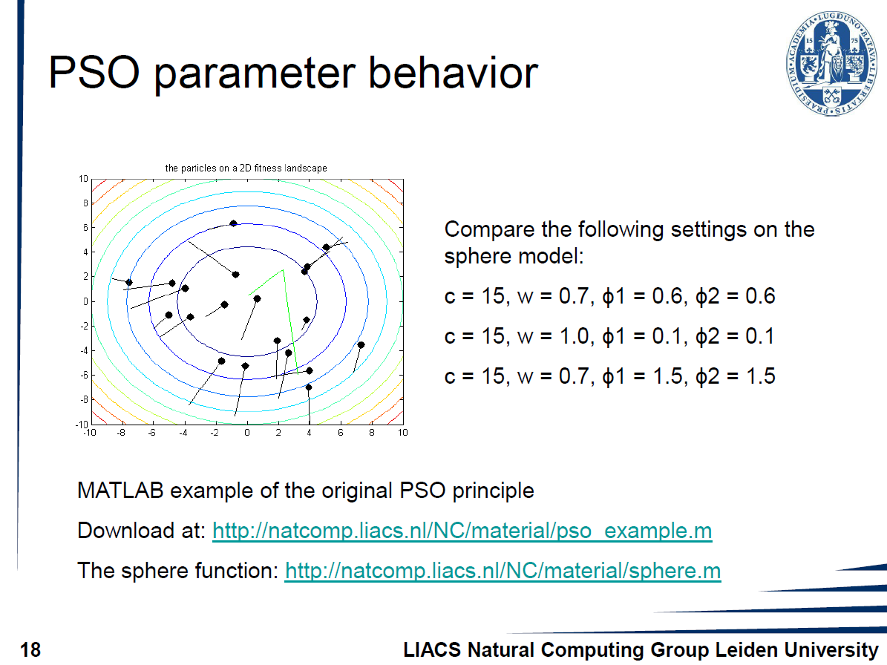

Slide 33
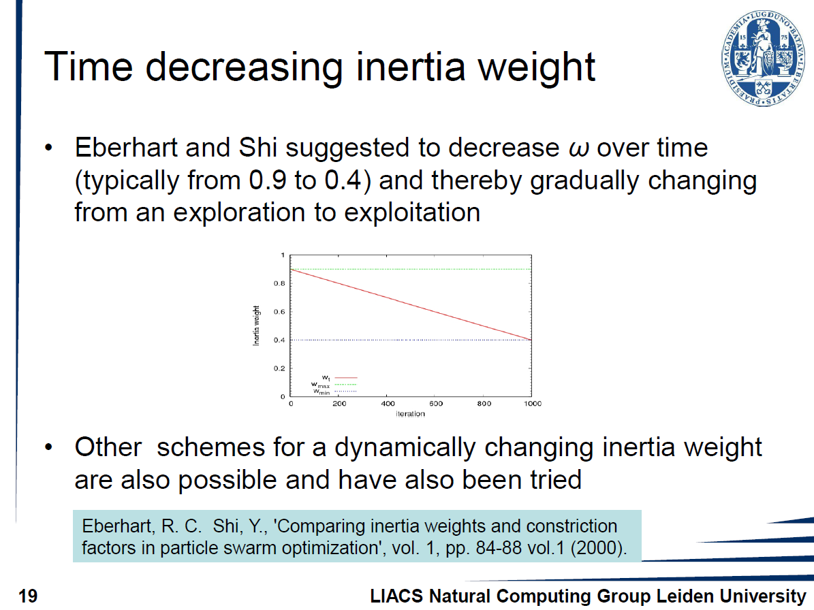

Slide 34
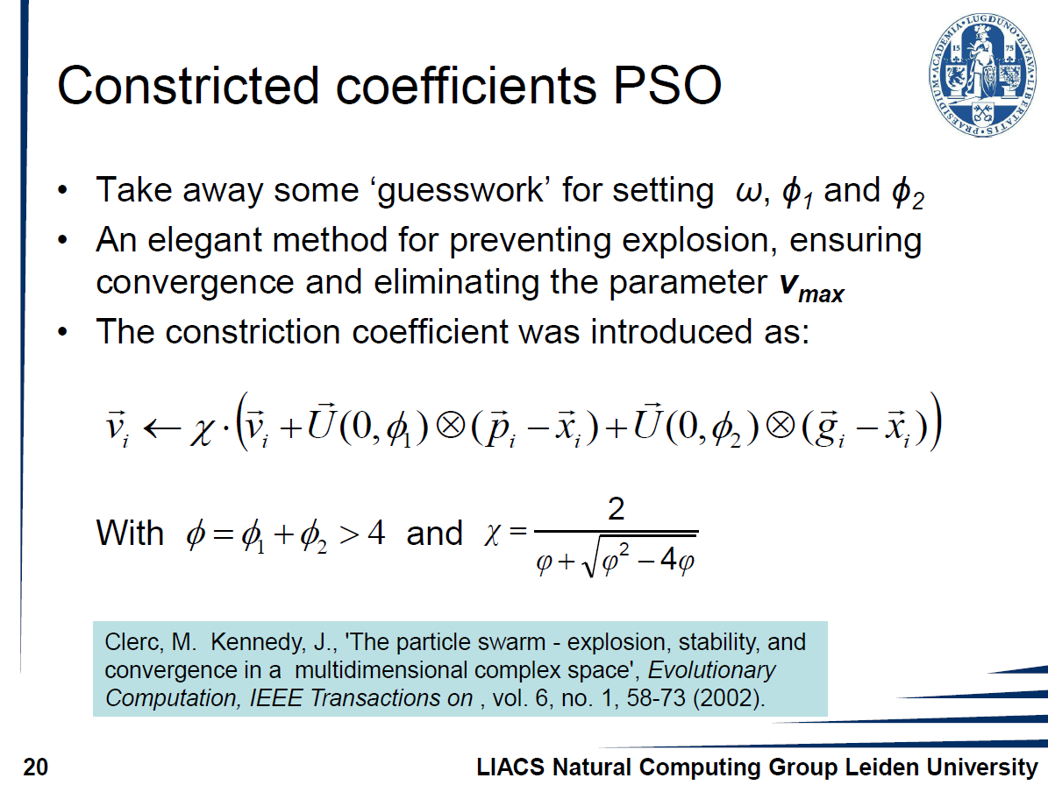

Slide 35
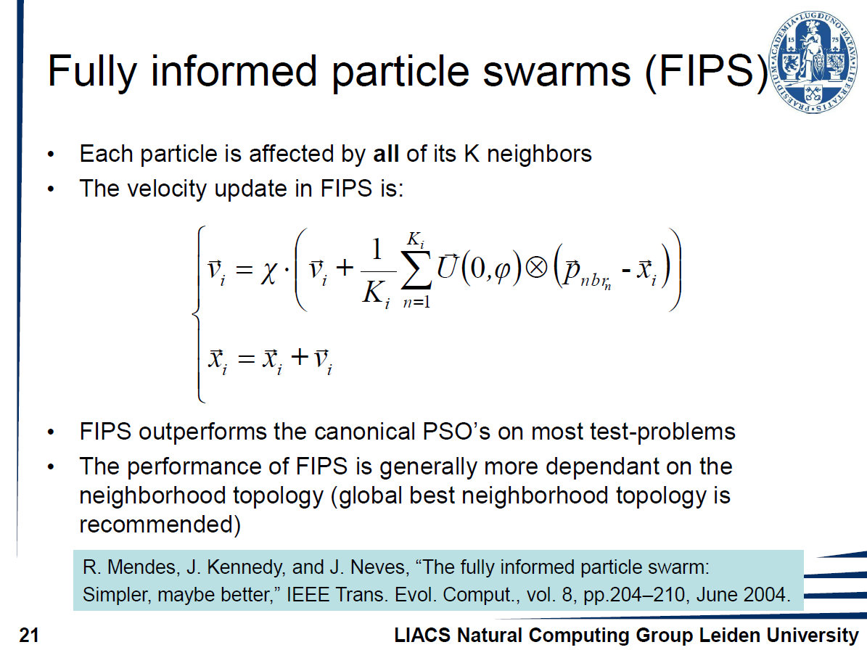

Slide 36
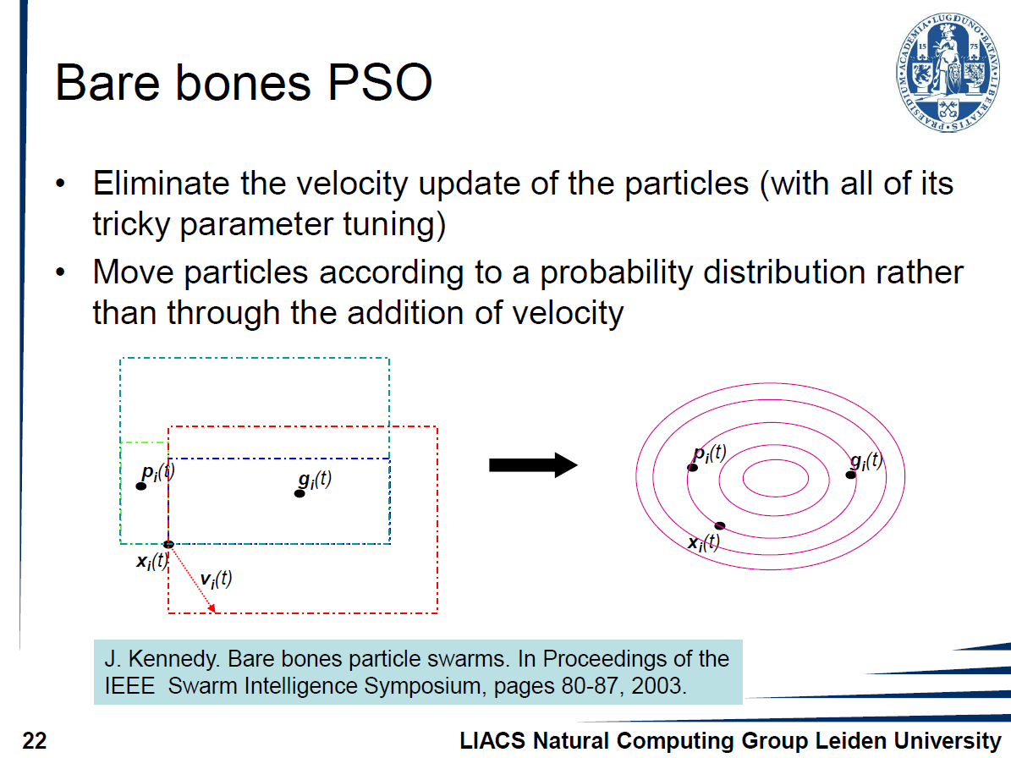

Slide 37
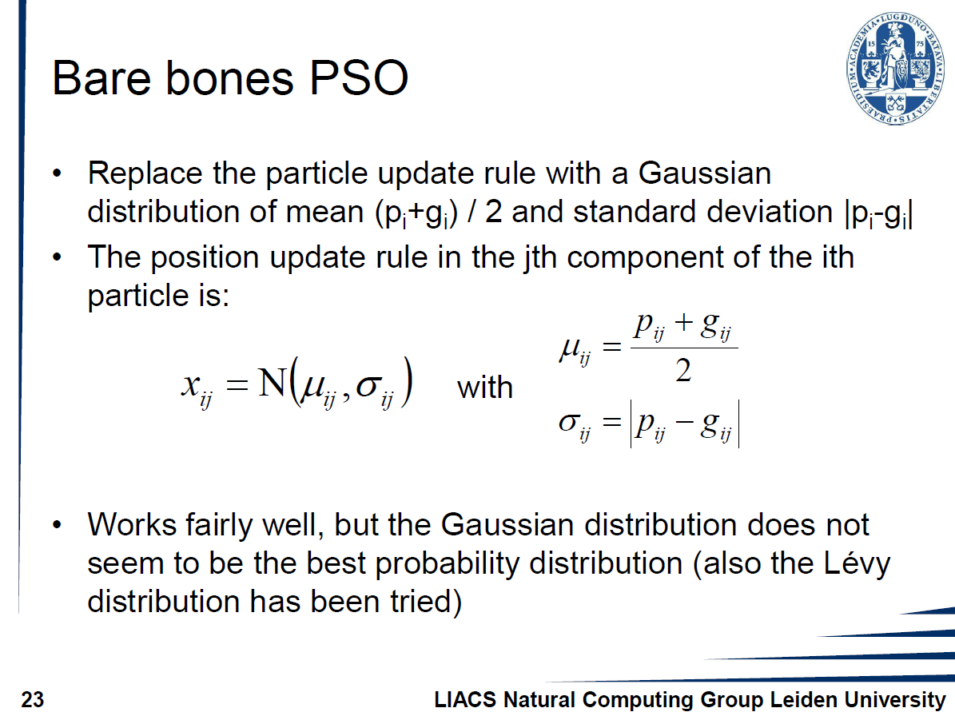

Slide 38
Standard Particle Swarm Optimisation 2011--Maurice.Clerc
1.Initialisation of the swarm:
pick a random position and a random velocity
2. Swarm size
3 Topology
3.1 The ring topology
3.2 The adaptive random topology: each particle informs K random particles after each unsuccessful iteration

Slide 39
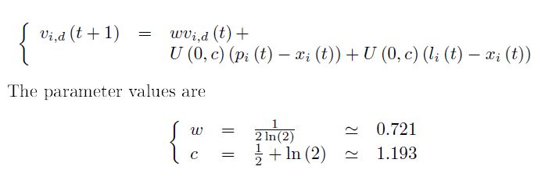
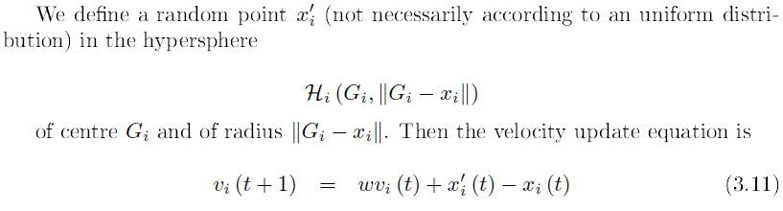
Standard Particle Swarm Optimisation 2011--Maurice.Clerc
4 The velocity update equations
4.1 SPSO 2006
and 2007
4.2 SPSO 2011

Slide 40
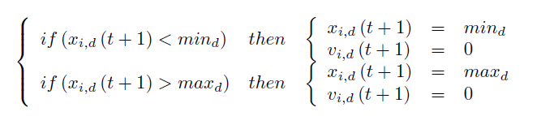
5 Confinement
5.1 SPSO 2006 and 2007:
5.2 SPSO 2011:the formulae are quite similar, except that the velocity is not set to zero

Slide 41
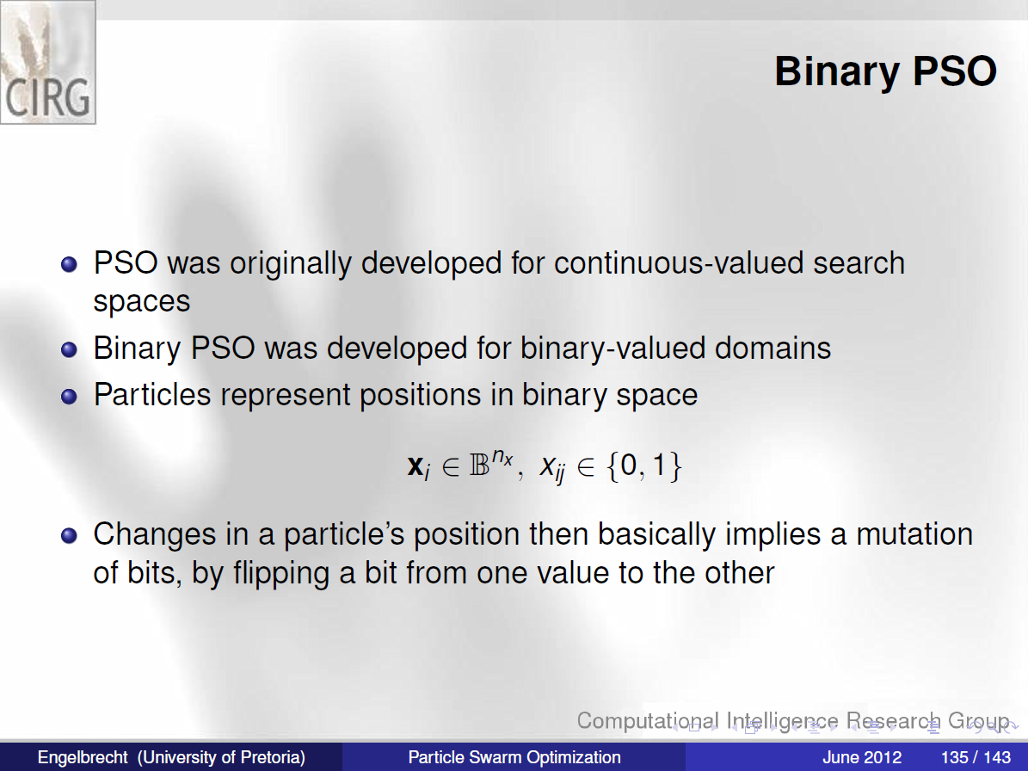
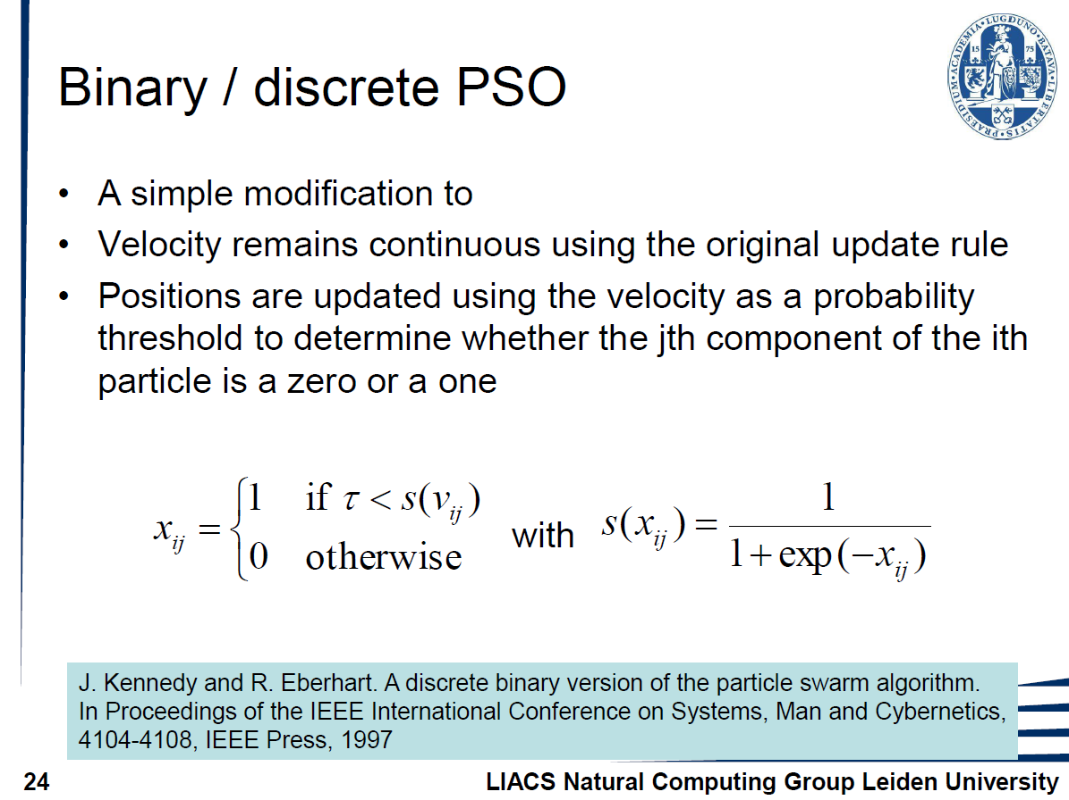

Slide 42
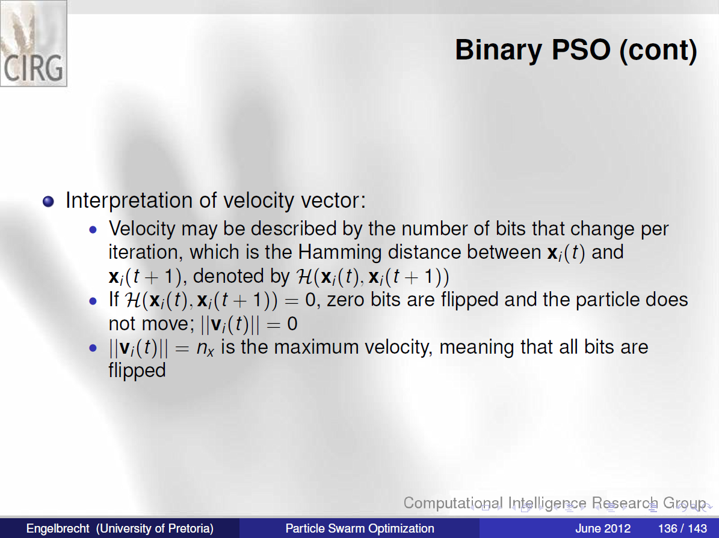

Slide 43
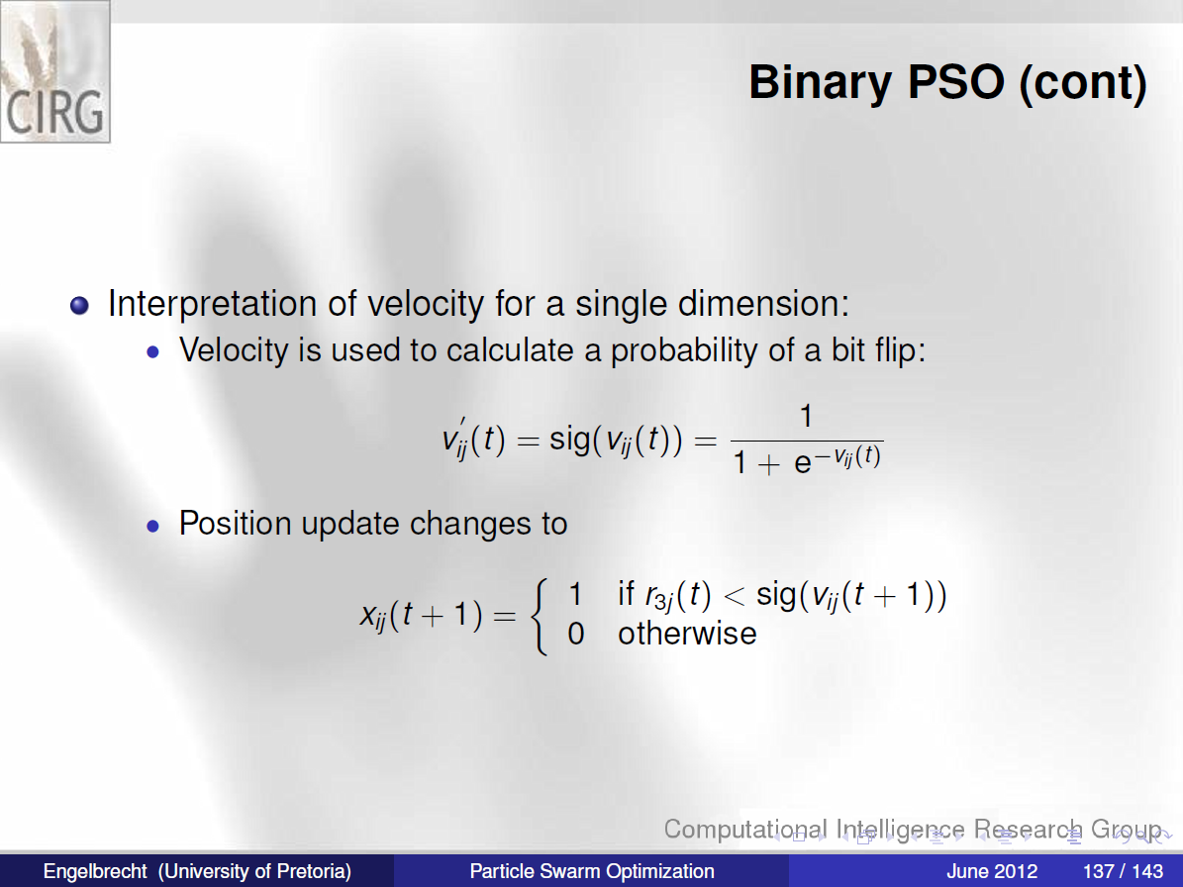
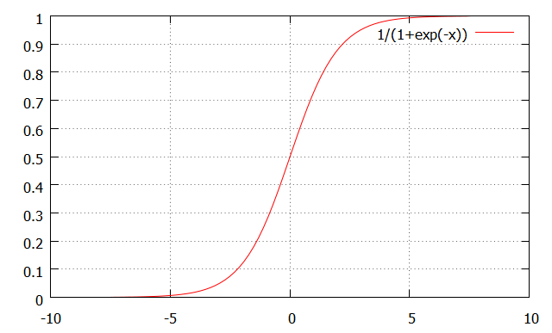
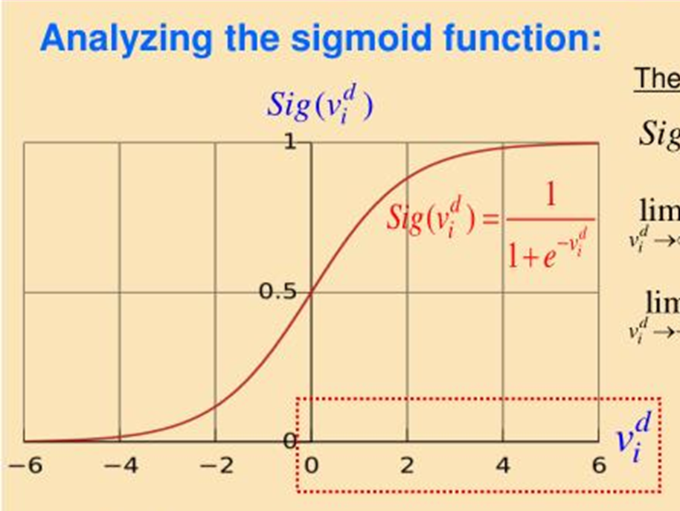

Slide 44
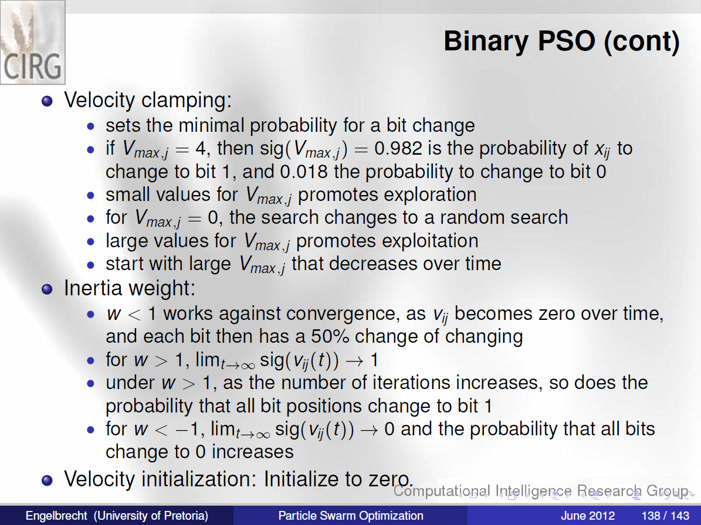

Slide 45
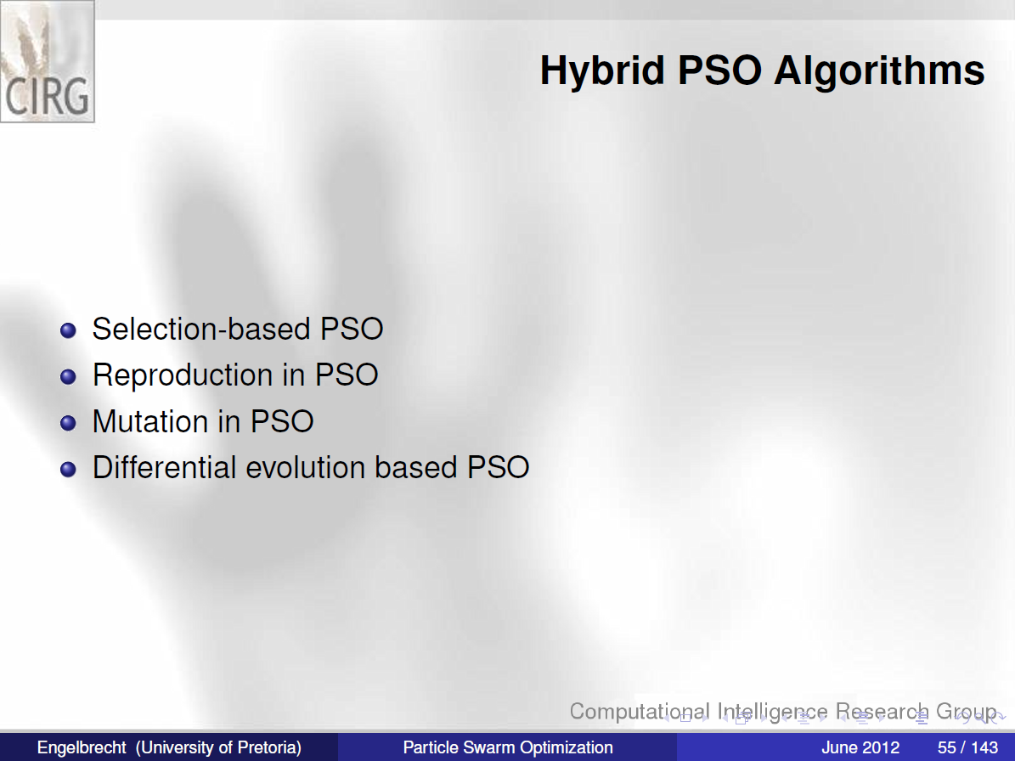

Slide 46
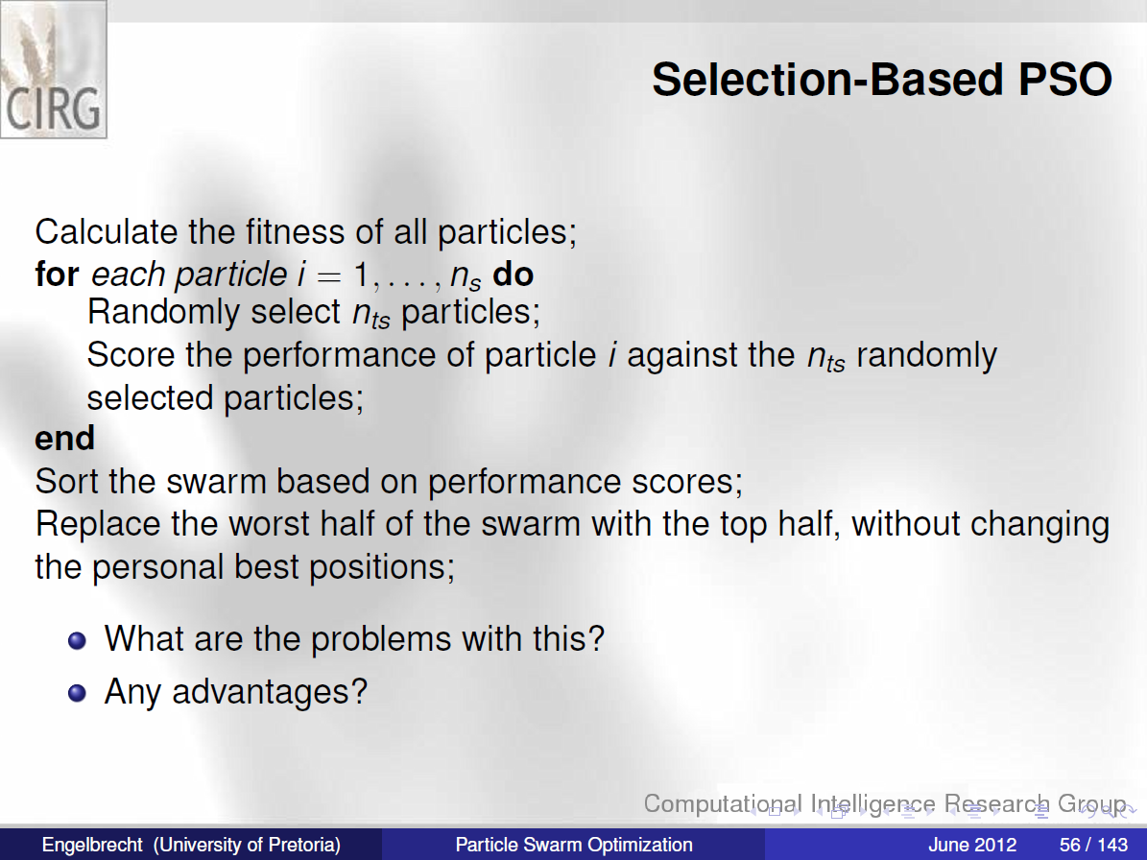

Slide 47

H. Wang, Y. Liu, C. Li and S. Zeng.A Hybrid Particle Swarm Algorithm with Cauchy Mutation. In proc. of the 2007 IEEE Swarm Intelligence Symposium
H. Wang, Y.Liu, S. Zeng and C.Li.Opposition-based Particle Swarm Algorithm with Cauchy Mutation. CEC2007
C. Li, Y. Liu, L. Kang and A. Zhou.A Fast Particle Swarm Optimization Algorithm with Cauchy Mutation and Natural Selection Strategy. Springer Press,ISICA2007

Slide 48


Slide 49


Slide 50


Slide 51



Slide 52


Slide 53


Slide 54


Slide 55
Practice
1. Implement PSO with gbest and lbest(ring) to compare their behaviors on the Sphere function and the Schwefel function.
2. For the sphere function, PSO with inertial weight model, try different w,c1,c2
3. Implement the SPSO 07 and 11 and some traditional models, e.g. FIFO
4. Try to solve 8-queen problem by b-PSO.

